Slide 1
Network Security Management
Key Issues

Slide 2

Network Access Security

Slide 3
Dangerous Accounts
Every account on a network is a door to the outside,through which both authorized and unauthorized users can enter. Some of the weak and potentially dangerous accounts are:
  Accounts without passwords
  Default accounts
  Group accounts
  Dormant Accounts

Slide 4
Accounts Without Passwords
Like the lock on the front door of a building , account password is the system’s first line of defense.
An account without a password is a door without a lock
Many ‘crackers’ succeed only because they are good at finding accounts with no or weak passwords

Slide 5
Default Accounts
Many OS come with default accounts, either with standard or without pass-words, e.g. root, admin, guest etc.
Either disable or change the password of such accounts

Slide 6
Group Accounts
A group account is an account, which is used by more than one user
Group accounts are always a bad idea, since there is no accountability, possibility of security breach is high
Instead of creating a group account, always create individual account and make them members of common group

Slide 7
Dormant Accounts
Dormant accounts are the accounts which are not currently in use, due to the absence of the user for some or other reasons. Such accounts are easy targets for intuders
To prevent intrusion either disable the account or change its password

Slide 8
Login Restrictions...
Through login restrictions users access to the network can be controlled.e.g.
  Disabling account
  Account expiration date
  Limiting concurrent logins
  Login time restrictions
  Login address restriction
  Intruder lockout

Slide 9
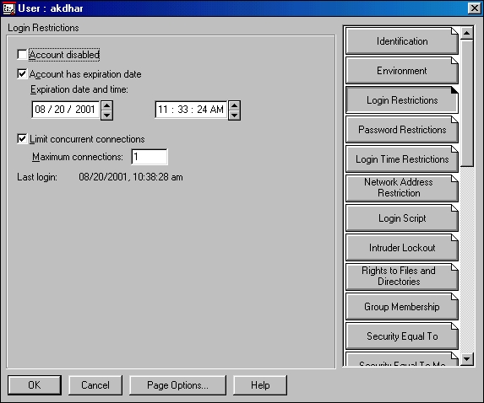
Login Restrictions...

Slide 10
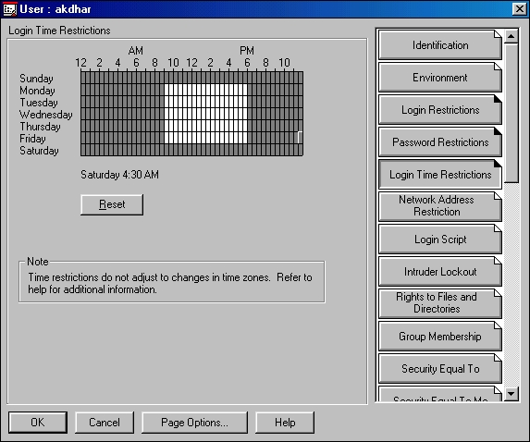
Login Restrictions...

Slide 11
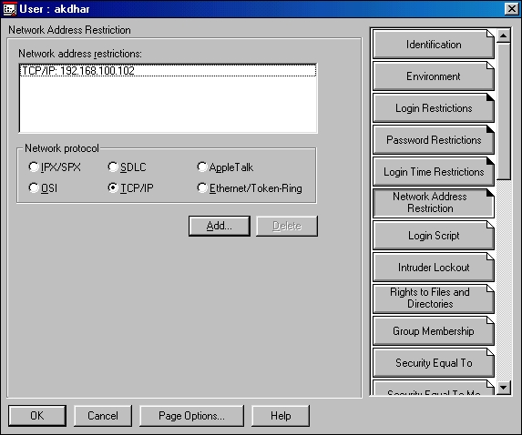
Login Restrictions...

Slide 12
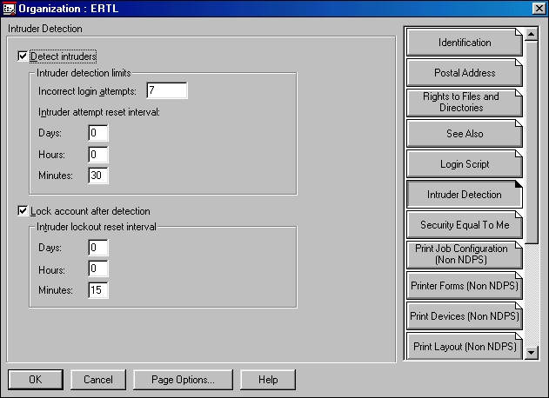
Login Restrictions

Slide 13
Password Restrictions...
Getting users to pick good passwords can be very difficult. Because a single user with a weak password can compromise the security of the entire network, many OS has facilities to put different restrictions in the passwords

Slide 14
Password Restrictions...
Some OS password restrictions
  Minimum and maximum age of passwords
  Number of days of warning before a password expires
  Minimum length of a password
  Unique passwords

Slide 15
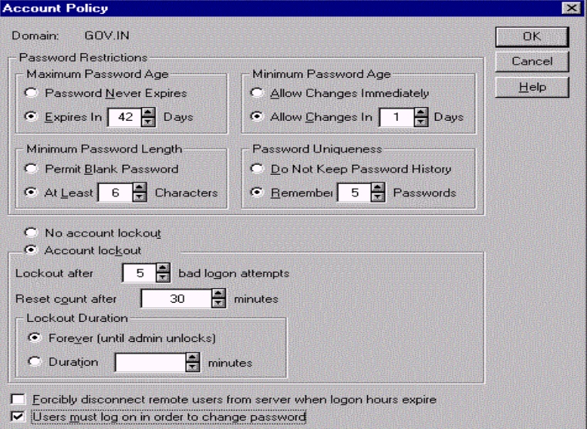
Password Restrictions...

Slide 16
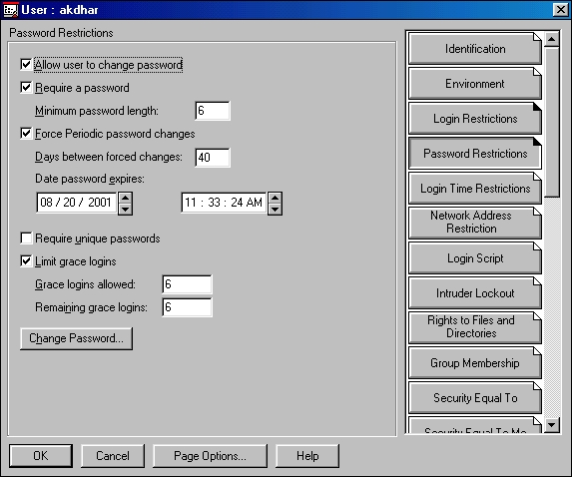
Password Restrictions

Slide 17
Password Tips…
Include combination of upper and lowercase letters, digits and special characters
Should be at least 6 characters long
Should be easy to remember so that they need not be written down
Avoid your name, spouse/child’s name, pet’s name, friend’s/coworker’s name, anybody’s name etc.
Avoid your phone no., car no. etc.
Avoid any other personal information e.g. alma mater, address, birthday etc.

Slide 18
Password Tips…
Avoid words from English or foreign dictionary
Avoid names of places, cities and any proper nouns
Avoid simple patterns of letters on the keyboard e.g. qwerty
Avoid any of the above spelled backwards or followed /pre-pended by a digit
Avoid using series of same characters
Change the password , time to time

Slide 19
Password Tips
Don’t attach the password to your terminal, keyboard, or any part of your copmputer
If it is required to write down the password, write it cryptically and don’t identify as password
Don’t record a password online (in a file or database), unless it is encrypted
Never send password to another user via e-mail
Don’t use your network login password in other application programs especially in www server accounts

Slide 20

File Security

Slide 21
What is File Security
File system security regulates access to the files and directories in network servers and controls how users access that information

Slide 22
File Security Concepts
To understand file system security following concepts must be understood
  Directory and file rights
  Trustees / ACL
  Inheritance and inheritance rights filter (IRF)
  Effective rights
  File and directory attributes

Slide 23

Directory and File Rights...
Rights determine the type of access a user has to network directories and files.
Rights are expressed in short hand by a single letter as R for ‘Read’, W for ‘Write’ etc.
[RWCEMFA]

Slide 24
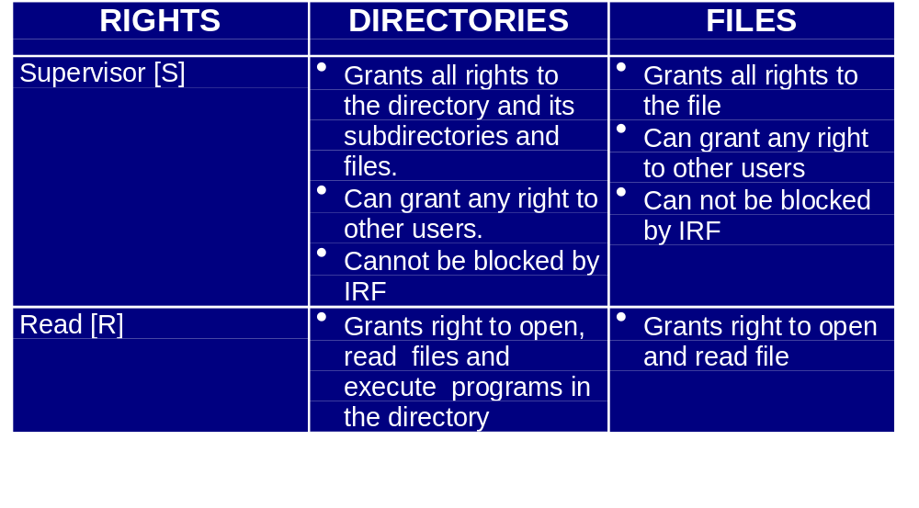
Directory and File Rights...

Slide 25
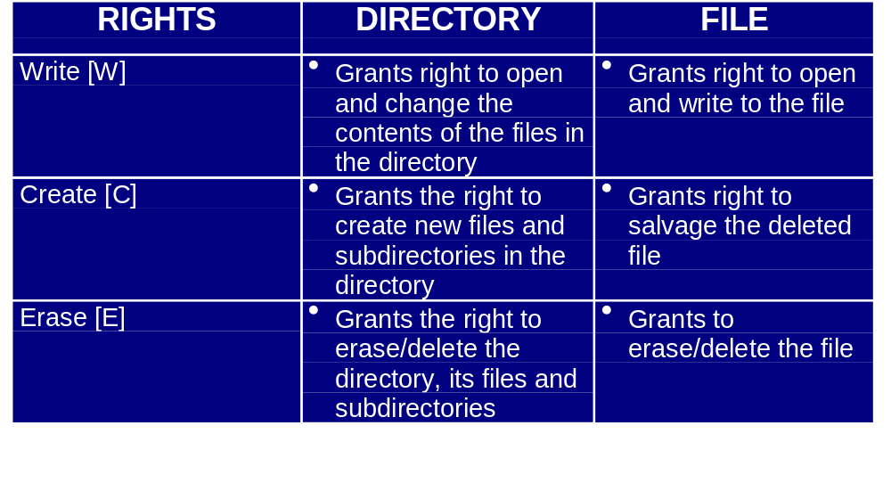
Directory and File Rights...

Slide 26
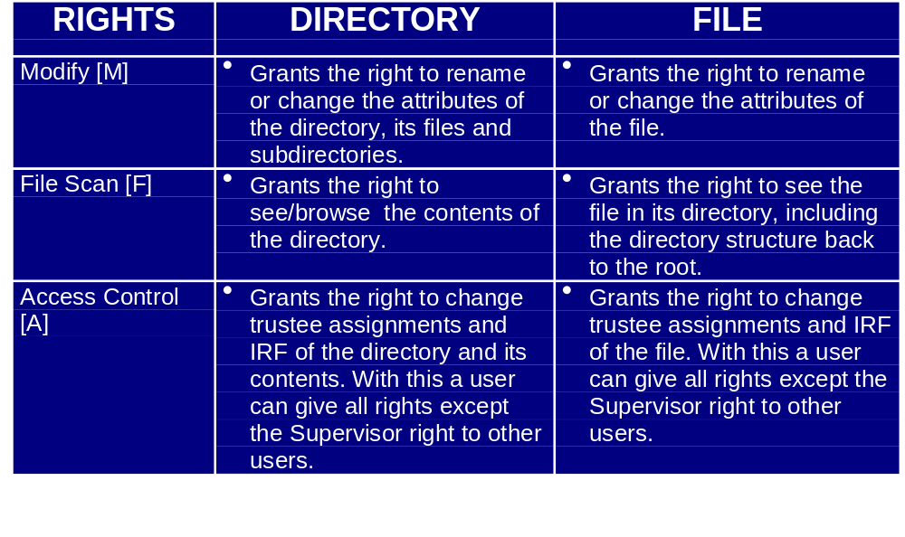
Directory and File Rights

Slide 27
Trustees
Every directory and file has an Access Control List(ACL). The ACL is a list which shows who has what rights to that directory or file
A trustee is an object that has been placed on the ACL of the directory or file. An object (user, group, container, organizational role [Public] trustee etc.) must be a trustee to get access rights to directory/file

Slide 28
Inherited Right Filter (IRF)
An IRF controls the rights that a trustee can inherit from parent directories
The IRF of a directory/file does not block rights that are granted to a trustee of the same directory/file. Only those rights that are inherited from higher level are blocked
The supervisor right cannot be blocked

Slide 29
Effective Rights
Effective rights are those rights a user can exercise on a given directory or file.
They are combination of all rights granted in any way to a user(user object, group object, security equivalence etc.) minus those rights revoked by IRFs

Slide 30

Example: Effective Right
Group rights granted above
[ RWCE F]
Shared
Acct
-
[SR____ F]
IRF
Acctg
=
[ R F]
Acct
User Right
+
[ W M ]
Effective Right
=
[ RW MF]
Ram

Slide 31
File and Directory Attributes...
Attributes are special properties of directories and files
It specifies how a directory/file can be managed by all users. For example , if a file is flagged with the Read Only(Ro) attribute, no user, regardless of his/her file system rights, can write to that file

Slide 32
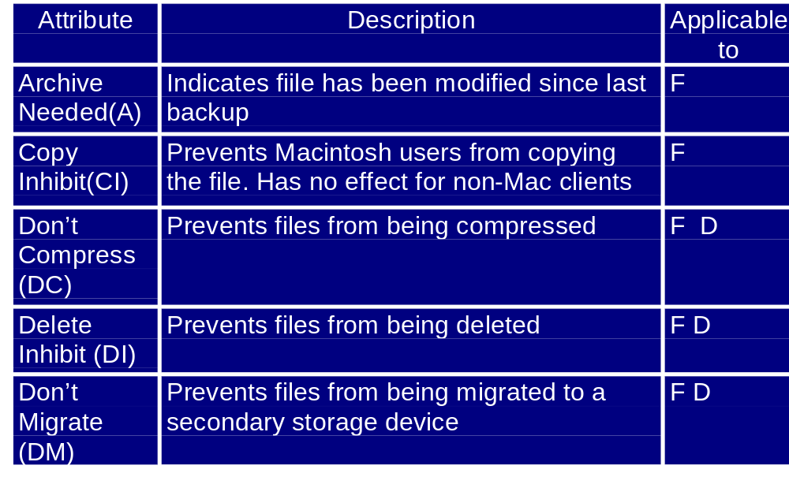
File and Directory Attributes...

Slide 33
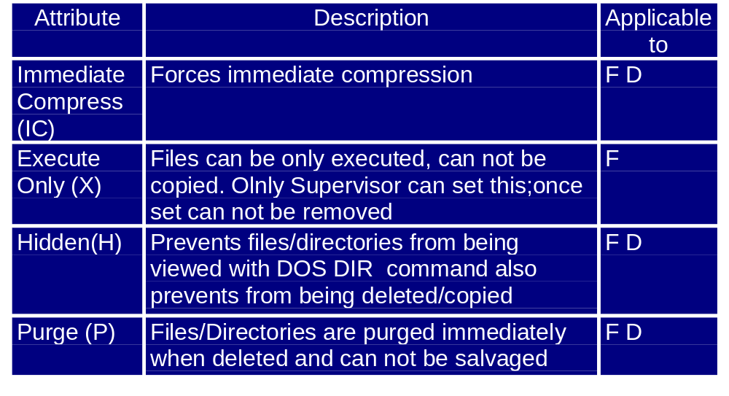
File and Directory Attributes...

Slide 34
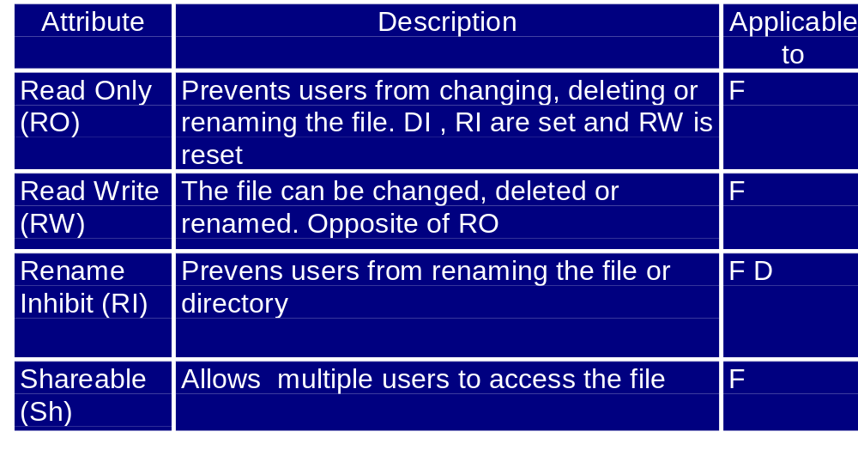
File and Directory Attributes...

Slide 35
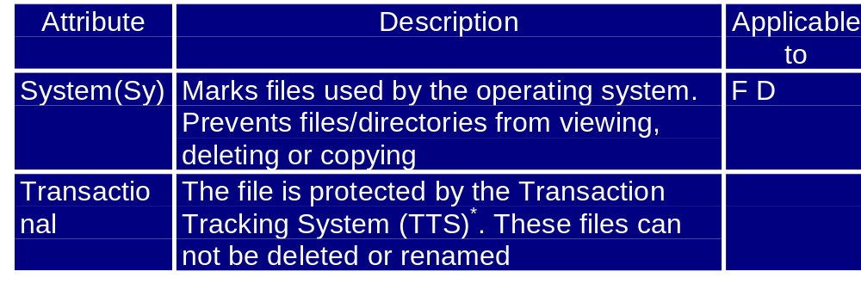
File and Directory Attributes
* TTS: It protects database files that might otherwise be corrupted if a server crashes during an incomplete transaction. The incomplete transaction is completely backed out and must be reentered.

Slide 36

Backup

Slide 37
Why Backup
To recover valuable data and to restore system in the event of disaster due to
  User / System-staff error
  Hardware /Software failure
  Crackers/Malicious code
  Theft
  Natural Disaster
  Archival of information

Slide 38
Types of Back up
Full backup
Incremental backup
Differential back up

Slide 39
Full Backup
Slowest but most comprehensive
Every file on the source disc is copied
It clears the archive bits of the all files of the source disc
Restoring from full backup is straight forward --- use the set of full backup tapes

Slide 40
Incremental Backup
Copies only those files for which the archive bit is set
Clears the archive bit after backup
Saves backup time and backup media
Restoration has to be done first from the full backup tapes then from the incremental backup tapes in order of creation

Slide 41
Differential Backup
It only backs up the files, modified since the last full or incremental backup
It does not alter the archive bit setting
Takes more space than incremental bkp
Restoration is simple-- restore from the full backup and the latest differential backup

Slide 42
Backup Plan
Need 5 to 8 sets of tapes for the first month depending on the scheme and need 1 set of tape per month for as long as you want to be able to recover data
Daily backups: Mark tapes (Mon…Thu) and take backup on the corresponding days. Store the tapes in a safe place. For full backup you need 4 tapes whereas for incremental/differential backup you need 1 tape
Weekly backups: Mark tapes(Fri1…Fri4) and take backup on corresponding Friday. Store the tape off-site
Monthly backups: Mark tapes(Jan, Feb so on)and take a full backup on the last Friday of the corresponding month. Store the tapes off-site

Slide 43
DOs and DON’Ts ...
Make regular backups
Be certain that everything on the system has been backed up
Remember to backup after any system/ configuration changes
Do not reuse backup tapes more than the manufacturer’s specification
Try to restore a few files from the backup tapes on a regular basis

Slide 44
DOs and DON’Ts
Try to completely rebuild the system from a set of backup tapes to be certain that the backup procedure is complete
Store a copy of backup off-site
Ensure access to the backups by authorized and trusted individuals only
If possible think of encrypting the backups

Slide 45

Fault Tolerant System

Slide 46
System Fault Tolerance
Fault tolerant system is designed by using redundant hardware (hard disk, disk controller, whole server) to protect the system in the event of hardware failure

Slide 47
SFT Techniques
Disk Mirroring
Disk Duplexing
RAID
Clustering

Slide 48
Disk Mirroring
Data is written in two separate disks, which are effectively mirror images of each other
Primary
Drive
Mirroring backup drive
Controller card
Data

Slide 49
Disk Duplexing
Disk duplexing implements separate controllers for each disk
Primary
Drive
Mirroring backup drive
Data

Slide 50
RAID
The term RAID (Redundant Array of Independent Disks) was first coined by a research group at the University of California Berkeley to describe a collection of disk drives (disk array) which can:
  Collectively act as a single storage system
  Tolerate the failure of a drive without losing data
  Function independently of each other

Slide 51
RAID Level 0
It does not actually provide redundancy, and so does not truly merit the RAID acronym
Data is split across several drives, resulting in higher throughput
It is commonly referred to as disk stripping

Slide 52
RAID Level 1
It provides redundancy by duplicating all data of one drive to another drive
If either drive fails no data is lost
As two drives are required for storing data cost per megabyte is high
This is referred to as disk mirroring

Slide 53
RAID Level 2
It is intended for use with drives which do not have built-in error correction codes
Since most of the SCSI drives support built-in error detection, this level is of little use

Slide 54
RAID Level 3
It stripes data at byte level across several drives and also stores parity information in a separate drive (parity drive)
If a data drive fails, the controller reconstruct the data on-the-fly from the parity information using an algorithm, so the users can continue work
If the parity drive fails, data continues to be written to the data drives

Slide 55
RAID Level 4
Similar to RAID Level 3, except it stripes data at a block level across several drives instead of byte level

Slide 56
RAID Level 5
Similar to RAID Level 4, but differs in that it distributes parity information across drives
A portion of the each drive is used for storing the parity information for the other drives
This helps to remove the bottleneck of failure of the parity drive in RAID Level 3 and 4

Slide 57
Clustering
It is a collection of computers which work together like a single system. If a computer crashes other good computers can serve the clients request.
A combination of clustering and disk mirroring can provide a very secure environment. In addition to maintaining integrity and high availability it gives scalability

Slide 58

Malicious Code

Slide 59
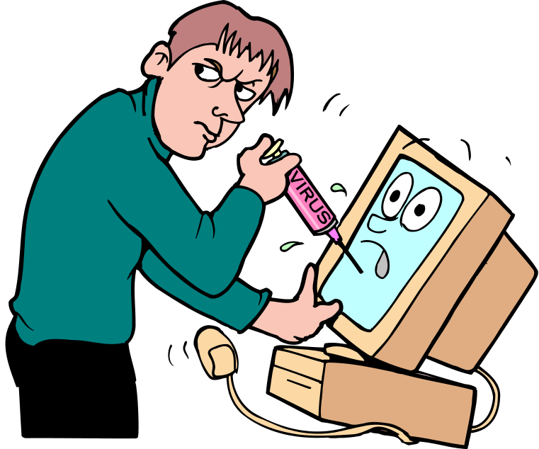
Types of Malicious Codes
Viruses
Worms
Trojan Horses
Back doors/Trap doors
Logic Bombs
Bacteria/Rabbit

Slide 60
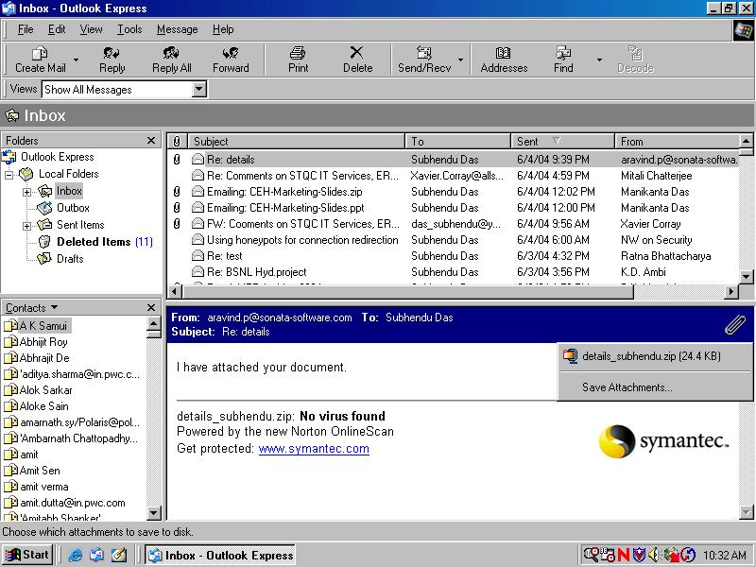
A typical malicious mail

Slide 61
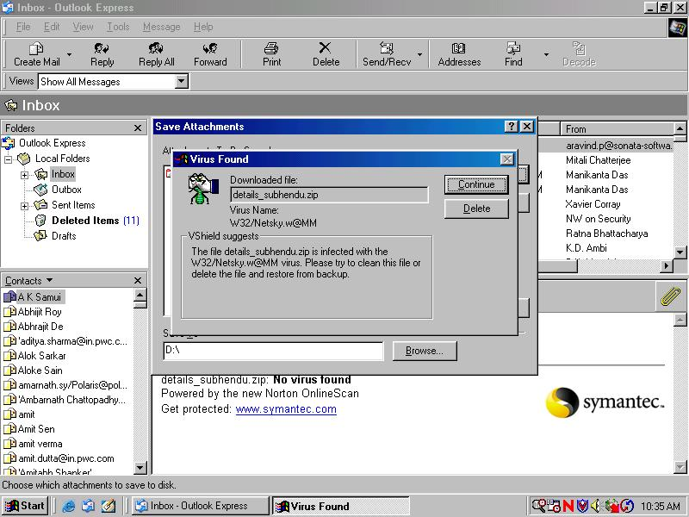
Anti-virus detection

Slide 62
Viruses
A true virus is a sequence of code that is inserted into other executable code, so that when the regular program is run, the viral code is also executed.
Viruses modify other programs on a computer, inserting copies of themselves

Slide 63
Different Types of Viruses...
Boot sector viruses: They infect either the DOS boot sector or the master boot record of the disk and execute during booting.
File infectors: They are parasitic viruses that attach themselves to executable files. These viruses are activated, when the program is run.
Macro viruses: They come attached with documents with macro (built in program) facility like MS Office documents. When the document is opened the viruses are activated

Slide 64
Different Types of Viruses
Multipartite viruses: They combine boot-sector with file infectors
Polymorphic viruses: They alter themselves when they replicate so that anti-virus software looking for specific patterns known as signature, will not find them all.

Slide 65
Worms
Worms are programs that can run independently and travel from machine to machine across network connections
They each create a copy of itself. This self replication spreads worms like flood in networks causing slowdown and even breakdown of network services

Slide 66
Trojan Horses
It is a program that appears to be innocent and useful but it also contains hidden and unintended function that presents a security risk
It does not replicate but it can steal passwords, delete data, format hard disks or cause other problems

Slide 67
Back Doors/Trap Doors
These are pieces of code written into applications to grant special access to programs bypassing normal methods of authentication.
This special codes used by developers during debugging can be present in the released program both unintentionally/ intentionally is a security risk

Slide 68
Logic Bombs
Logic bombs are programmed threats that lie dormant in commonly used software for an extended period of time until they are triggered when some pre conditions are met like presence of certain files, a particular day etc.
Logic bombs come embedded with some programs

Slide 69
Bacteria/Rabbits
These programs do not damage files. Their purpose is to deny access to the resources by consuming all processor capability/memory/disk space, by self-replicating themselves.

Slide 70
Damages Caused by the Malicious Codes
The damages range from merely annoying to catastrophic (loss of data services)
Disclosure of information
Loss of reputation or legal consequences for software firms if he inadvertently ships software containing any malicious code

Slide 71
Authors/Creators
Disgruntled employees
Spies
Experimenters
Publicity Hounds
Political activists

Slide 72
Protecting Tips ...
Be careful about installing new software. Never install binaries obtained from untrustworthy sources
When installing new software, install it first on a non-critical system and test for mis-behaviour/bugs
Periodically review all system start-up and configuration files for changes

Slide 73
Protecting Tips ...
Turn off the the automatic open on receipt feature from your email software
Before opening any attachments first scan it using updated anti-virus software.
Regularly update anti-virus software engine and data files
Deselect the Windows 98 default setting of ‘Hide file extension’

Slide 74
Protecting Tips
While opening any .DOC file attachment using WORD disable macro
Turn off Visual Basic Scripting (also known as Windows Scripting Host (WSH))
When not in use turn off the workstation or disconnect it from the network
Make regular backup of critical data and system files

Slide 75
Physical Security

Slide 76
What is Physical Security
Protecting network infrastructure from unauthorized physical access and environmental hazards.
It is the first line of defense to protect the network services and resources
Physical security should be implemented in such a way that even if it fails to prevent an attack, it should at least create an audit trail for investigators

Slide 77
Physical Security Measures...
Develop a physical security plan that includes a description of the assets, environment, threats,defenses etc.
Define who has physical access to which resources.
Install fire alarms and fire extinguishers at suitable locations.
Train users and operators about what to do when an alarm sounds.

Slide 78
Physical Security Measures...
Strictly prohibit smoking, eating and drinking near computer equipment
Keep backups offsite
Keep the servers and critical computer equipment in controlled environment
Install UPS, surge protectors for critical computer equipment
Restrict public entry in server rooms

Slide 79
Physical Security Measures...
Protect all network cables, terminators, hubs, switches and connectors from tampering. Examine them periodically
Use locks, tie-downs, bolts or other means to protect computer equipment / peripherals from theft. A wide variety of software and devices are available to prevent computer theft.

Slide 80
Physical Security Measures
Encrypt sensitive data held on the systems
Consider putting motion alarms, hidden camera to monitor unmanned site
Sanitize media (tapes, disks etc.) and hard copies before disposal. Bulk erasers, shredders can be used for this
Consider setting auto logout on user accounts

Slide 81
Personnel Security

Slide 82
What is Personnel Security
Personnel security is everything involving employees (who are potential elements of security breaches):
  hiring them
  training them
  monitoring them
  handling their departure

Slide 83
Why Personnel Security
Most of the security violations are caused by people only like, break-ins, virus generation etc.
Statistics tell that the most common perpetrators of significant network crime are those who have /had legitimate access to the network
Some studies show that over 80% of incidents are caused by internal users/employees
The security violations by the users may be deliberate or accidental

Slide 84
Background Checks
Verify the information furnished by the candidate,
  claims of educational/professional achievements
  references given by the candidate
  past employment history
If possible have an investigation agency do a background check
Check the candidate’s criminal records
Check the candidate’s credit record
Stringent checks are essential for the candidates who will be posted in a position of trust / privileged access

Slide 85
Training and Awareness
Training and awareness of the employees who has accesses to the network is an effective way of enhancing security. The following issues may be addressed
  The organization’s security policies
  What types of data may be shared with colleagues / public
  How to use the information processing facilities securely e.g. password selection, backup methods, email and internet usage, reporting of security incidents etc.
  Awareness about current threats and their consequences

Slide 86
Performance Appraisal
Performance of the staffs should be reviewed periodically and the staffs should be rewarded for good works. This prevents job frustration and stress.
Avoid creating situations in which staffs feel over worked, ignored or unappreciated. Creating such environment can lead to carelessness and lack of interest in protecting the organization’s interest.
Disgruntled staffs may do intentional damage. Watch for possible indicators of discontent ... low production output/quality, late arrival/ absenteeism, complaints etc.

Slide 87
Auditing Access
Ensure that auditing of network / data is enabled and is monitored
Ensure that anyone with such access knows that auditing is enabled. If a possible security violator knows that the activity and access are logged, he might be discouraged in his actions

Slide 88
Least Privilege
This principle states that, a person is given the minimum access necessary to do his job. This restricted access is both physical ( access to computers, backup tapes, peripherals etc.) and logical ( access to accounts, networks, programs etc.)

Slide 89
Separation of Duties
This principle states that , carefully separate duties so that people monitoring the inappropriate use are not capable of making such inappropriate use. Thus, having all the security functions and audit responsibilities reside in the same person is dangerous

Slide 90
Departure Handling
Follow a standard procedure for handling employee departure.
  closing his account and removing all access rights
  changing critical passwords and access codes
  take over all data files, especially encrypted files and the keys to decrypt them
  Take a signed undertaking from the departing employee that he has not kept any copy of the organization’s sensitive information
  when an employee leaves on unfriendly terms, his access to he system should be restricted as quickly as possible

Slide 91
Thank You

